Slide 1



xx/06/2024
SYNC
REPORT #3
marco.labarbera@mail.polimi.it
giulio.lotto@mail.polimi.it

Slide 2
ALVEARE
ALVEARE is a comprehensive framework that presents a solution which achieves a 34x speedup execution factors and enhances RE performance thanks to the following aspects:
RE-tailored domain-specialized ISA based on RISC architecture
Specialized microarchitecture for the efficient execution of REs
Novel hardware mechanism to handle speculative counter modes (greedy and lazy)

Slide 3
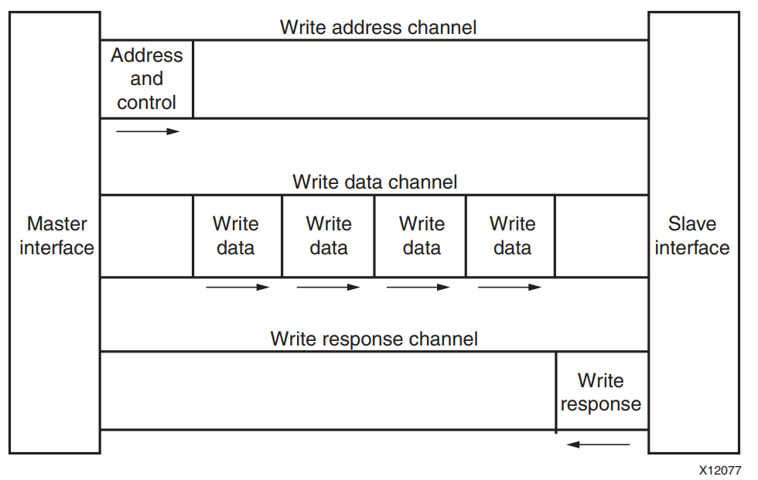
AXI4
AXI4 is a memory-mapped protocols, this means that all transactions involve the concept of transferring a target address within a system memory space and data.
What do we need?
ALVEARE needs to know where data are mapped
Manage data mapping
Addresses
Data (for sure...)
https://docs.xilinx.com/v/u/en-US/ug1037-vivado-axi-reference-guide

Slide 4
Slide presentazione
ALU
SIMD
MIMD
Dec

Slide 5

A
B
A
B
SIMD
DRAM
A | B
RES
IP ALU
Master1
Master2
Master0
ZYNQ
OPERATION,
ADDRESSES
Slave Port

Slide 6
A
B
A
B
MIMD
DRAM
A | B | OP
RES
IP ALU
Master1
Master2
Master3
Master0
ZYNQ
ADDRESSES
Slave Port

Slide 7
SELEC=0
DECOUPLED MIMD
DRAM
A | B | OP
RES
SELEC=0
SELEC=1
Master1
Master2
Master3
Master0
SELEC=2
SELEC,
ADDRESSES
ZYNQ
OLD A
Slave Port
NEW A
OLD B
NEW B
NEW OP
OLD OP

Slide 8
WHY IS THIS USEFUL?

Slide 9
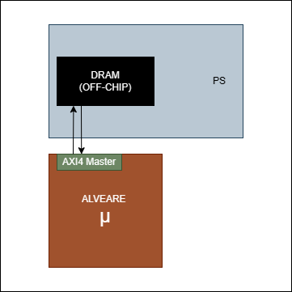


DRAM CONNECTION
Goal 01
In order to speed up data transfer the DMA has to be replaced with a direct connection from ALVEARE system to the DRAM.
DRAM connection has to be performed from PL to PS through an AXI4 communication system
ALVEARE is then scheduled to receive an enhancement with the integration of an AXI4 Master.

Slide 10
INPUT
OUTPUT
PATTERN
DATA
FOUND/NOT FOUND
POSITION

Slide 11
WHAT IF I WANT TO USE
A NEW PATTERN
BUT WITH AN OLD DATA SET?
A NEW DATA SET
BUT WITH THE OLD PATTERN?
Notes:
NON DIRE “PATTERN DI DATI”

Slide 12
SELEC=0
DECOUPLED MIMD
DRAM
A | B | OP
RES
ALU
Master1
Master2
Master3
Master0
SELEC,
ADDRESSES
ZYNQ
Slave Port

Slide 13
HLS IMPLEMENTATION

Slide 14
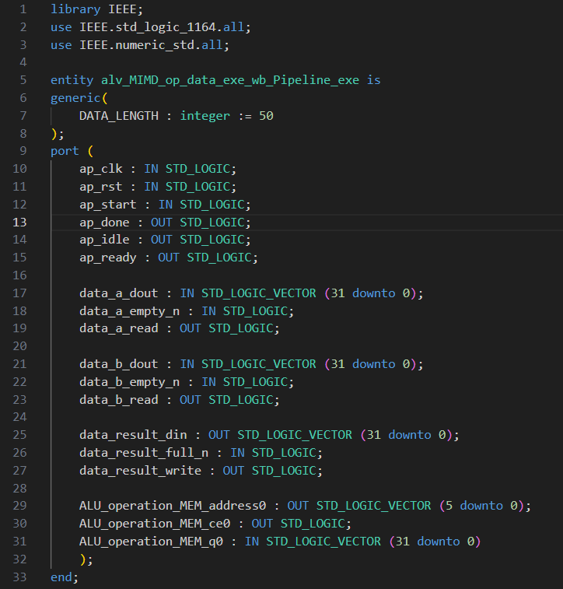
A
B
A
B
176 lines VS 1437

Slide 15
THANK YOU FOR YOUR ATTENTION
marco.labarbera@mail.polimi.it
giulio.lotto@mail.polimi.it

